Slide 1
Chapter 20
The Baroque in the Netherlands

Slide 2
Learning Objectives
Assess the influence of Caravaggio on Northern Baroque artists.
Explore the variations of Baroque art in the North and South Netherlands and the reasons for this difference.
Discover how Dutch artists explored new subject matter to cater to the needs of new patrons.
Explore the changing concept and use of self-portraiture.
Evaluate the role of light in the art of Rembrandt and Vermeer.

Slide 3
Flanders
The northern provinces of the Netherlands rebelled against Spain in 1568 and only achieved independence in 1648.
It was known as the Peace of Westphalia.
Flanders, the southern part of the Netherlands, returned to direct Spanish rule in 1621.
Catholic churches were restored, among many other important sacred works.
Following religious wars, artists such as Rubens and van Dyck established reputations there

Slide 4
Rubens (1 of 4)
The work of Peter Paul Rubens typifies the Flemish Baroque style.
Rubens visited every major Italian city, returning to Antwerp in 1609 to accept a position as court painter to the Habsburg regents of Flanders.
His first painting there commemorated his marriage to Isabella Brandt, which occurred ten days after he arrived.

Slide 5
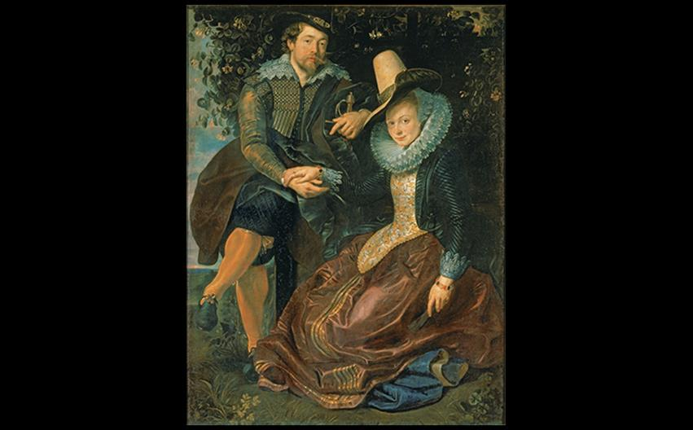
Peter Paul Rubens SELF-PORTRAIT WITH ISABELLA BRANDT 1609–1610. Oil on canvas, 5'9" × 4'5" (1.78 × 1.36 m). Alte Pinakothek, Munich. Photo © Blauel Gnamm/ARTOTHEK.
Notes:
Peter Paul Rubens SELF-PORTRAIT WITH ISABELLA BRANDT 1609–1610. Oil on canvas, 5'9" × 4'5" (1.78 × 1.36 m). Alte Pinakothek, Munich. Photo © Blauel Gnamm/ARTOTHEK.

Slide 6
Rubens (2 of 4)
His first major commission in Antwerp was the Raising of the Cross triptych for the church of St. Walpurga.
This work uniquely stretches the action and landscape of the central scene across all three panels.

Slide 7
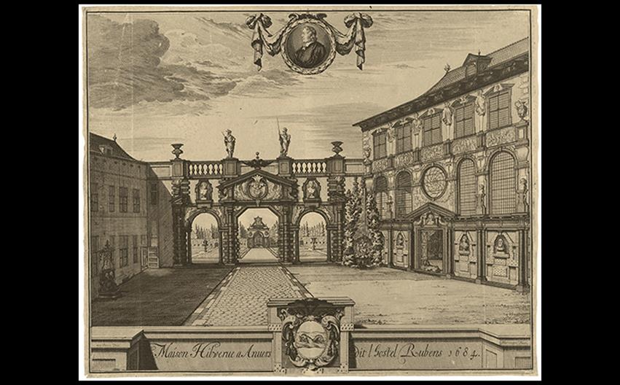
Peter Paul Rubens RUBENS'S HOUSE Italianate addition built 1610–1615. Looking toward the garden: house at left, studio at right; house restored and opened as a museum in 1946. From an engraving of 1684. Rijksmuseum, Amsterdam.
Notes:
Peter Paul Rubens RUBENS'S HOUSE Italianate addition built 1610–1615. Looking toward the garden: house at left, studio at right; house restored and opened as a museum in 1946. From an engraving of 1684. Rijksmuseum, Amsterdam.

Slide 8
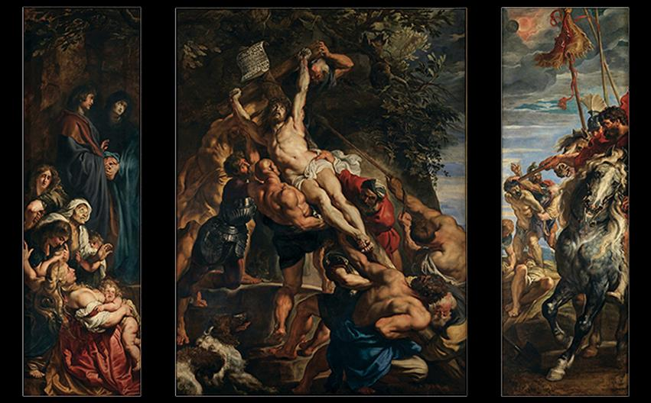
Peter Paul Rubens THE RAISING OF THE CROSS Made for the church of St. Walpurga, Antwerp, Belgium. 1610-1611. Oil on panel, center panel 15'1-7/8" × 11'1-1/2" (4.62 × 3.39 m), each wing 15'1-7/8" × 4'11" (4.62 × 1.52 m). Now in Cathedral of Our Lady, Antwerp. Onze Lieve Vrouwkerk, Antwerp Cathedral, Belgium/Bridgeman Images.
Notes:
Peter Paul Rubens THE RAISING OF THE CROSS Made for the church of St. Walpurga, Antwerp, Belgium. 1610-1611. Oil on panel, center panel 15'1-7/8" × 11'1-1/2" (4.62 × 3.39 m), each wing 15'1-7/8" × 4'11" (4.62 × 1.52 m). Now in Cathedral of Our Lady, Antwerp. Onze Lieve Vrouwkerk, Antwerp Cathedral, Belgium/Bridgeman Images.

Slide 9
Rubens (3 of 4)
In the painting of the royal engagement of Henry IV and Marie de' Medici, Henry IV is seen falling in love with Marie as he gazes at her portrait; he is surrounded by Roman gods in full, lavish color.

Slide 10
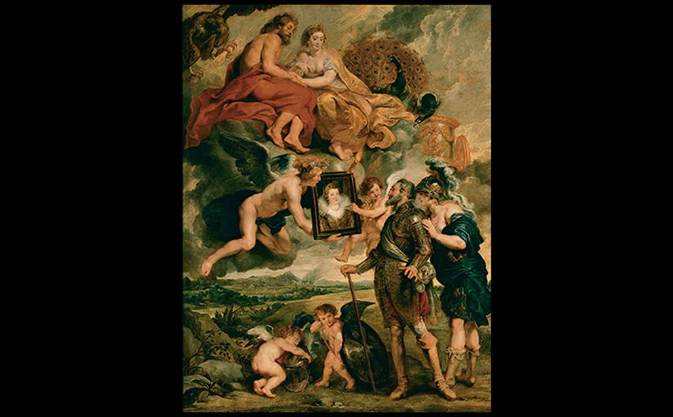
Peter Paul Rubens HENRY IV RECEIVING THE PORTRAIT OF MARIE DE' MEDICI 1621–1625. Oil on canvas, 12'11-1/8" × 9'8-1/8" (3.94 × 2.95 m). Musée du Louvre, Paris. Photo © RMN-Grand Palais (Musée du Louvre)/René-Gabriel Ojéda/Thierry Le Mage.
Notes:
Peter Paul Rubens HENRY IV RECEIVING THE PORTRAIT OF MARIE DE' MEDICI 1621–1625. Oil on canvas, 12'11-1/8" × 9'8-1/8" (3.94 × 2.95 m). Musée du Louvre, Paris. Photo © RMN-Grand Palais (Musée du Louvre)/René-Gabriel Ojéda/Thierry Le Mage

Slide 11
Rubens (4 of 4)
For Prometheus Bound, Rubens brought in Frans Snyders to paint the large eagle who devours Prometheus's liver.
Elements of lighting, composition, and energetic brushwork identify Rubens's style, while Snyders's imprint is tight and detailed.

Slide 12
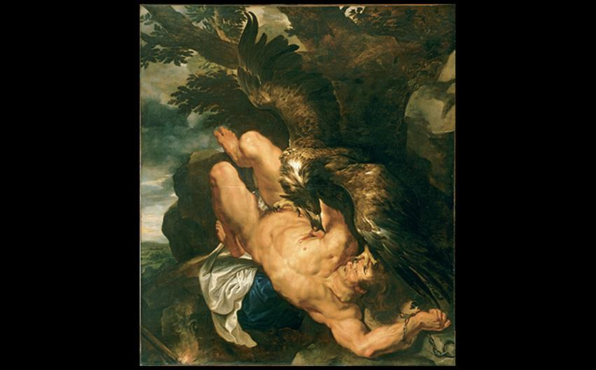
A CLOSER LOOK: Prometheus Bound by Peter Paul Rubens and Frans Snyders c. 1611–1618. Oil on canvas, 95-1/2" × 82-1/2" (2.43 × 2.1 m). Philadelphia Museum of Art. © 2016. Photo The Philadelphia Museum of Art/Art Resource/Scala, Florence.
Notes:
A CLOSER LOOK: Prometheus Bound by Peter Paul Rubens and Frans Snyders c. 1611–1618. Oil on canvas, 95-1/2" × 82-1/2" (2.43 × 2.1 m). Philadelphia Museum of Art. © 2016. Photo The Philadelphia Museum of Art/Art Resource/Scala, Florence.

Slide 13
Van Dyck and Peeters: Portraits and Still Lifes (1 of 2)
Anthony van Dyck associated with Rubens as a specialist in painting heads.
Charles I at the Hunt portrayed the king truthfully short but with imposing presence.
Both the horse and the tree branches bow to him in forms that echo the lines of his hat.

Slide 14
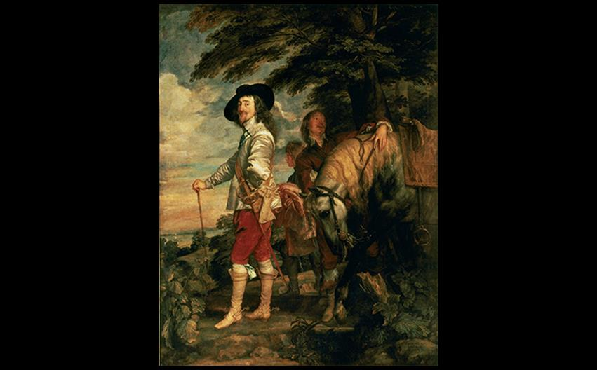
Anthony van Dyck CHARLES I AT THE HUNT 1635. Oil on canvas, 8'11" × 6'11" (2.75 × 2.14 m). Musée du Louvre, Paris. Photo © Photo RMN (Musee du Louvre, Paris).
Notes:
Anthony van Dyck CHARLES I AT THE HUNT 1635. Oil on canvas, 8'11" × 6'11" (2.75 × 2.14 m). Musée du Louvre, Paris. Photo © Photo RMN (Musee du Louvre, Paris).

Slide 15
Van Dyck and Peeters: Portraits and Still Lifes (2 of 2)
Clara Peeters's Still Life with Flowers, Goblet, Dried Fruit, and Pretzels shows an arrangement of tableware and food against a neutral background to emphasize surface textures of the objects.

Slide 16
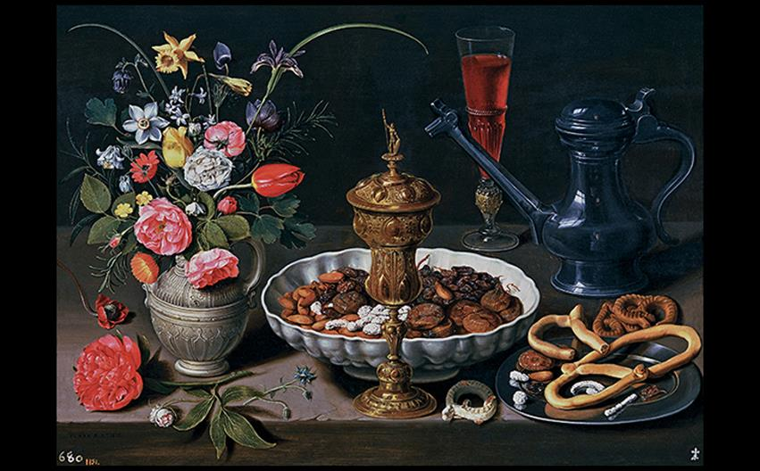
Clara Peeters STILL LIFE WITH FLOWERS, GOBLET, DRIED FRUIT, AND PRETZELS 1611. Oil on panel, 20-1/2" × 28-3/4" (52 × 73 cm). Museo del Prado, Madrid. © 2016. Image Copyright Museo Nacional del Prado. © Photo MNP/Scala, Florence.
Notes:
Clara Peeters STILL LIFE WITH FLOWERS, GOBLET, DRIED FRUIT, AND PRETZELS 1611. Oil on panel, 20-1/2" × 28-3/4" (52 × 73 cm). Museo del Prado, Madrid. © 2016. Image Copyright Museo Nacional del Prado. © Photo MNP/Scala, Florence.

Slide 17
The Dutch Republic
Prince Frederick Henry improved patronage of the arts in the House of Orange.
The Dutch were interested in scenes depicting themselves and their country, as well as history, mythology, science, and colonial exploration.
Art was popular among merchants and working people.

Slide 18
Painting (1 of 14)
Hendrick ter Brugghen introduced Caravaggio's influential style in paintings such as St. Sebastian Tended by St. Irene.
The diagonal created by St. Sebastian's left arm dislodges him from the triangular stability of the group.
Crowding the figures to the foreground plane was another Caravaggesque element.

Slide 19
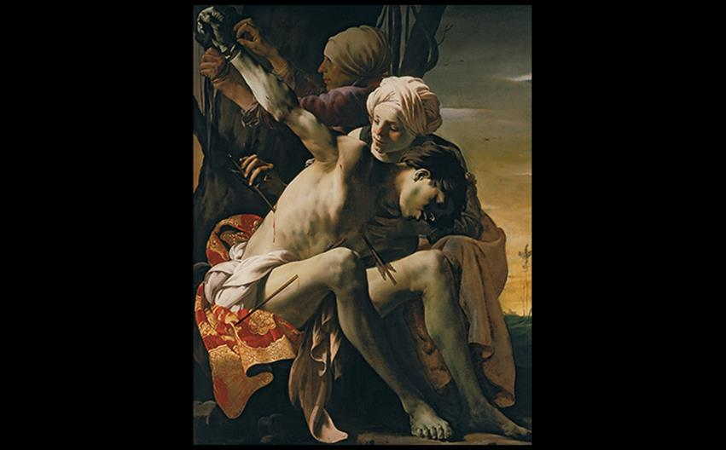
Hendrick ter Brugghen ST. SEBASTIAN TENDED BY ST. IRENE 1625. Oil on canvas, 58-15/16" × 47-1/2" (149.6 × 120 cm). Allen Memorial Art Museum, Oberlin College, Ohio. R.T. Miller Jr. Fund (1953.256). Bridgeman Images.
Notes:
Hendrick ter Brugghen ST. SEBASTIAN TENDED BY ST. IRENE 1625. Oil on canvas, 58-15/16" × 47-1/2" (149.6 × 120 cm). Allen Memorial Art Museum, Oberlin College, Ohio. R.T. Miller Jr. Fund (1953.256). Bridgeman Images.

Slide 20
Painting (2 of 14)
Hals and Leyster
Group portraiture documenting the membership of corporate organizations became popular in the Dutch Republic.
Officers of the Haarlem Militia Company of St. Adrian transforms the portrait into a social event.
Strong diagonal lines underlie the composition.

Slide 21
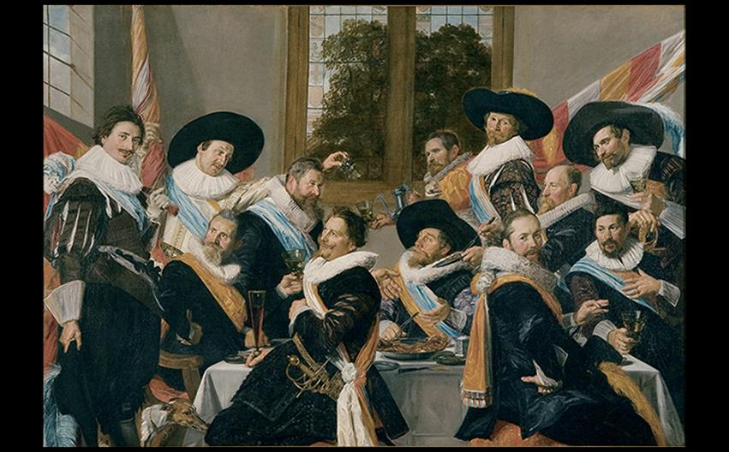
Frans Hals OFFICERS OF THE HAARLEM MILITIA COMPANY OF ST. ADRIAN c. 1627. Oil on canvas, 6' × 8'8" (1.83 × 2.67 m). Frans Halsmuseum, Haarlem. Photo: © Margareta Svensson.
Notes:
Frans Hals OFFICERS OF THE HAARLEM MILITIA COMPANY OF ST. ADRIAN c. 1627. Oil on canvas, 6' × 8'8" (1.83 × 2.67 m). Frans Halsmuseum, Haarlem. Photo: © Margareta Svensson.

Slide 22
Painting (3 of 14)
Hals and Leyster
Hals delighted in painting portraits of eccentric local figures that served doubly as genre paintings.
The subject of Malle Babbe was a well-known barmaid.
The technique in this character study is looser and more energetic than in formal portraits.

Slide 23
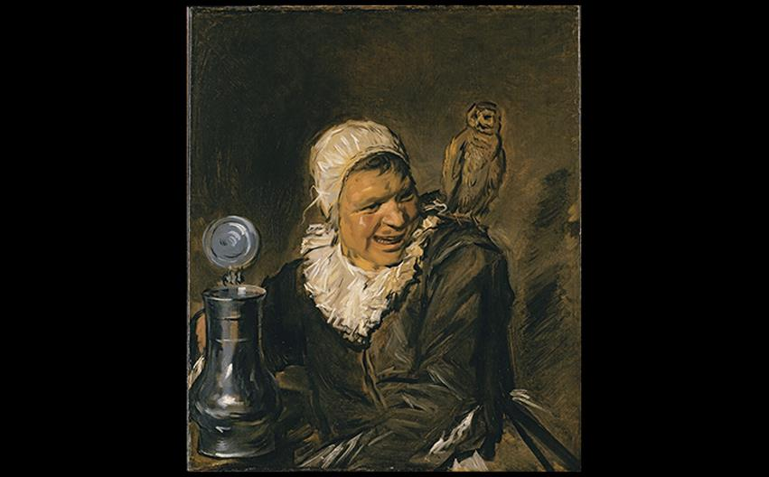
Frans Hals MALLE BABBE c. 1630–1633. Oil on canvas, 30-7/8" × 26" (78.5 × 66.2 cm). Staatliche Museen, Berlin. © 2016. Photo Scala, Florence/bpk, Bildagentur für Kunst, Kultur und Geschichte, Berlin.
Notes:
Frans Hals MALLE BABBE c. 1630–1633. Oil on canvas, 30-7/8" × 26" (78.5 × 66.2 cm). Staatliche Museen, Berlin. © 2016. Photo Scala, Florence/bpk, Bildagentur für Kunst, Kultur und Geschichte, Berlin.

Slide 24
Painting (4 of 14)
Hals and Leyster
Judith Leyster created portraits more typical of the Dutch painters of the time.
Self-Portrait is lively, showing two styles of painting as exhibited in her figure and the easel behind her.

Slide 25
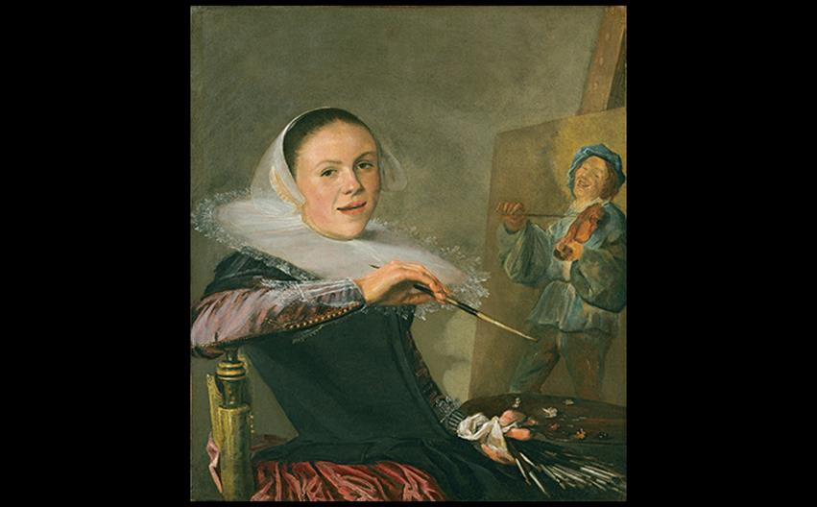
Judith Leyster SELF-PORTRAIT 1635. Oil on canvas, 29-3/8" × 25-5/8" (74.6 × 65.1 cm). National Gallery of Art, Washington, DC. Gift of Mr. and Mrs. Robert Woods Bliss (1949.6.4). Image courtesy the National Gallery of Art, Washington.
Notes:
Judith Leyster SELF-PORTRAIT 1635. Oil on canvas, 29-3/8" × 25-5/8" (74.6 × 65.1 cm). National Gallery of Art, Washington, DC. Gift of Mr. and Mrs. Robert Woods Bliss (1949.6.4). Image courtesy the National Gallery of Art, Washington.

Slide 26
Painting (5 of 14)
Rembrandt van Rijn
Rembrandt trained under Pieter Lastman and grew an interest in elements of the Caravaggesque style.
The Anatomy Lesson of Dr. Nicolaes Tulp is a charged moment from a life story rather than a posed portrait.
Figures' attentive faces are framed by brilliant white ruffs, contrasting the darkness of the ambiance.

Slide 27
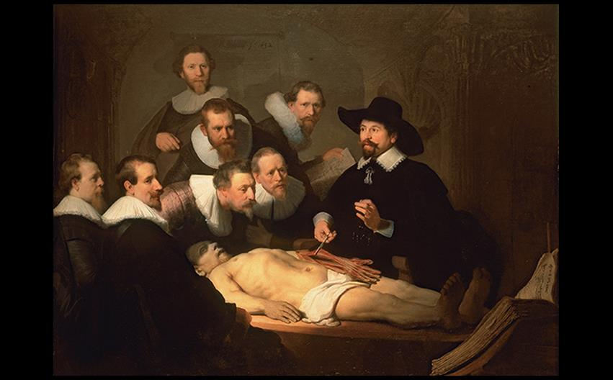
Rembrandt van Rijn THE ANATOMY LESSON OF DR. NICOLAES TULP 1632. Oil on canvas, 5'3-3/4" × 7'1-1/4" (1.6 × 2.1 m). Mauritshuis, The Hague. © 2016. Photo Scala, Florence.
Notes:
Rembrandt van Rijn THE ANATOMY LESSON OF DR. NICOLAES TULP 1632. Oil on canvas, 5'3-3/4" × 7'1-1/4" (1.6 × 2.1 m). Mauritshuis, The Hague. © 2016. Photo Scala, Florence.

Slide 28
Painting (6 of 14)
Rembrandt van Rijn
The Company of Captain Frans Banning Cocq transforms a group portrait into a dramatic event.
A girl in the gathering crowd carries a chicken with prominent claws, which is a pun in Dutch about the company's name, "The Kloveniers."

Slide 29
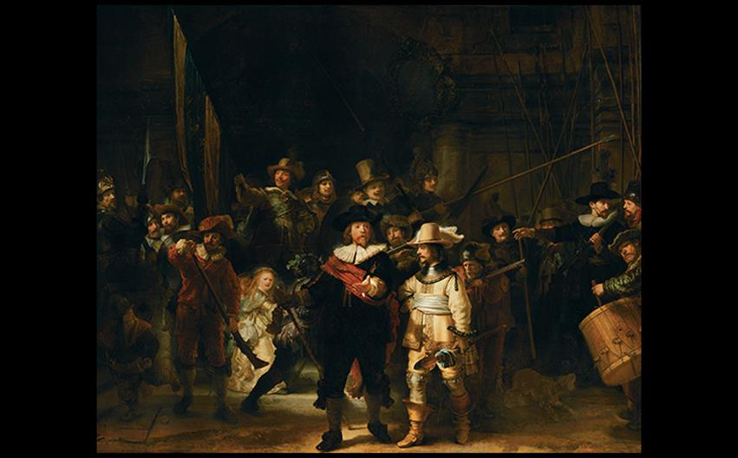
Rembrandt van Rijn THE COMPANY OF CAPTAIN FRANS BANNING COCQ (THE NIGHT WATCH) 1642. Oil on canvas, 11'11" × 14'4" (3.63 × 4.37 m) (cut down from the original size). Rijksmuseum, Amsterdam.
Notes:
Rembrandt van Rijn THE COMPANY OF CAPTAIN FRANS BANNING COCQ (THE NIGHT WATCH) 1642. Oil on canvas, 11'11" × 14'4" (3.63 × 4.37 m) (cut down from the original size). Rijksmuseum, Amsterdam.

Slide 30
Technique: Etching and Drypoint
Rembrandt popularized etching, which is an intaglio technique that carves designs out of the surface of a printing plate.
Metal is coated with an acid-resistant resin, then scratched into.
Drypoint is another intaglio technique in which a sharp needle directly scratches into the metal.

Slide 31
Painting (7 of 14)
Rembrandt van Rijn
In the Three Crosses, four states of the work exist and show Rembrandt's process from first anecdotal draft to the haunting blackness in the final state.

Slide 32
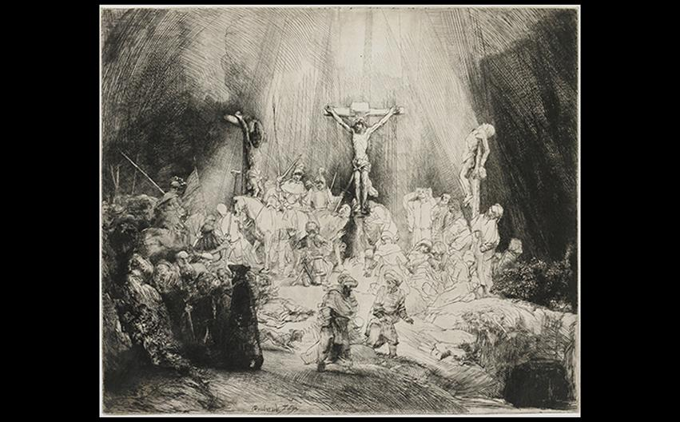
Rembrandt van Rijn THREE CROSSES (FIRST STATE) 1653. Drypoint, 15-1/6" × 17-3/4" (38.5 × 45 cm). Rijksmuseum, Amsterdam.
Notes:
Rembrandt van Rijn THREE CROSSES (FIRST STATE) 1653. Drypoint, 15-1/6" × 17-3/4" (38.5 × 45 cm). Rijksmuseum, Amsterdam.

Slide 33
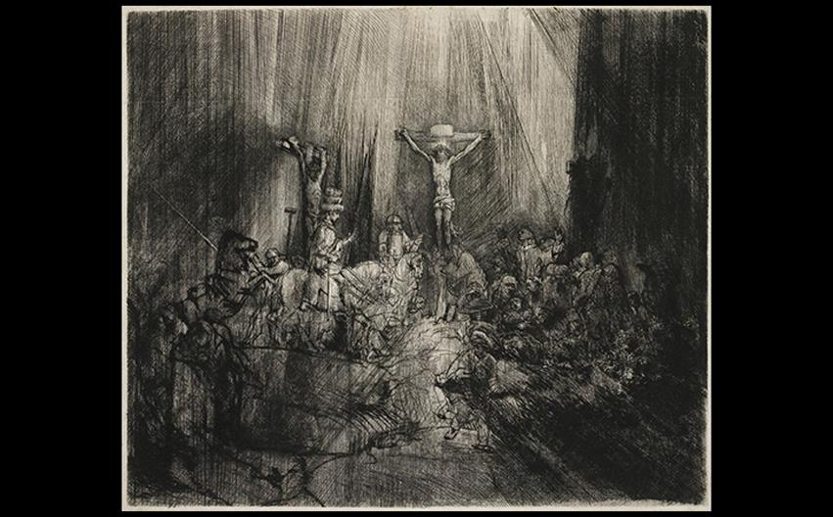
Rembrandt van Rijn THREE CROSSES (FOURTH STATE) 1653. Drypoint, 15-1/6" × 17-3/4" (38.5 × 45 cm). Rijksmuseum, Amsterdam.
Notes:
Rembrandt van Rijn THREE CROSSES (FOURTH STATE) 1653. Drypoint, 15-1/6" × 17-3/4" (38.5 × 45 cm). Rijksmuseum, Amsterdam.

Slide 34
Painting (8 of 14)
Rembrandt van Rijn
The aging artist used a wider range of textures in paint, creating a rich chiaroscuro ranging from thin glazes to impasto.
In a Self-Portrait of 1658, the artist's expression is inward and weary, reflecting his stressful bankruptcy.

Slide 35
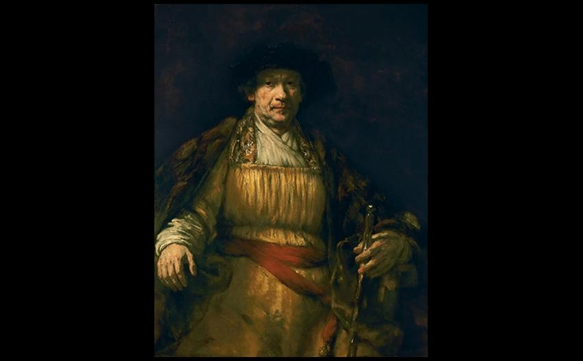
Rembrandt van Rijn SELF-PORTRAIT 1658. Oil on canvas, 52-5/8" × 40-7/8" (133.6 × 103.8 cm). The Frick Collection, New York. Henry Clay Frick Bequest. (1906.1.97). Photo: Michael Bodycomb.
Notes:
Rembrandt van Rijn SELF-PORTRAIT 1658. Oil on canvas, 52-5/8" × 40-7/8" (133.6 × 103.8 cm). The Frick Collection, New York. Henry Clay Frick Bequest. (1906.1.97). Photo: Michael Bodycomb.

Slide 36
Painting (9 of 14)
Johannes Vermeer
Although Vermeer produced fewer than 40 canvases that are indisputably his work, he was famous for his highly structured compositional approach.
View of Delft shows a city with timeless stability, and buildings moved for ideal placement.
It may have been aided by a camera obscura.

Slide 37
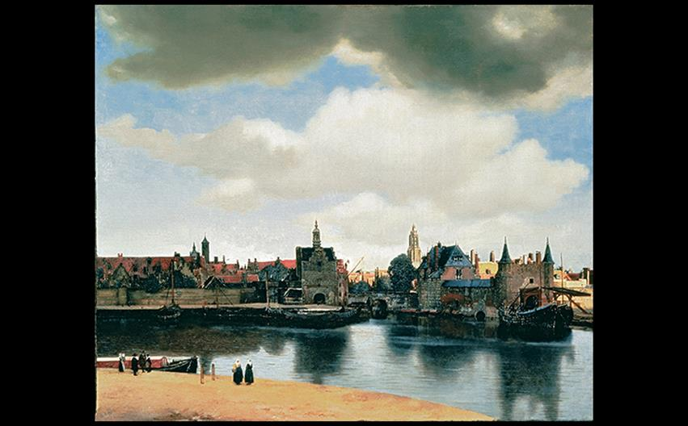
Johannes Vermeer VIEW OF DELFT c. 1662. Oil on canvas, 38-1/2" × 46-1/4" (97.8 × 117.5 cm). Royal Picture Gallery, Mauritshuis, The Hague.
Notes:
Johannes Vermeer VIEW OF DELFT c. 1662. Oil on canvas, 38-1/2" × 46-1/4" (97.8 × 117.5 cm). Royal Picture Gallery, Mauritshuis, The Hague.

Slide 38
Painting (10 of 14)
Johannes Vermeer
He also produced genre paintings of quiet interior scenes.
Woman Holding a Balance evokes the vanitas theme of the transience of earthly life as the woman stands underneath a painting of the Last Judgment.

Slide 39
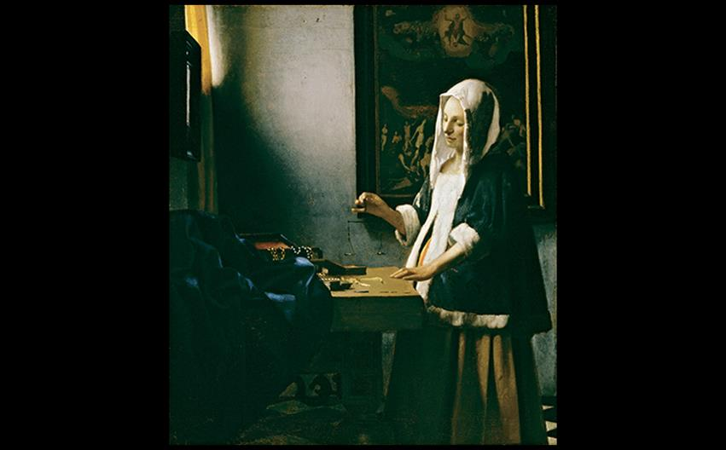
Johannes Vermeer WOMAN HOLDING A BALANCE c. 1664. Oil on canvas, 15-5/8" × 14" (39.7 × 35.5 cm). National Gallery of Art, Washington, DC. Widener Collection (1942.9.97). Image courtesy the National Gallery of Art, Washington.
Notes:
Johannes Vermeer WOMAN HOLDING A BALANCE c. 1664. Oil on canvas, 15-5/8" × 14" (39.7 × 35.5 cm). National Gallery of Art, Washington, DC. Widener Collection (1942.9.97). Image courtesy the National Gallery of Art, Washington.

Slide 40
Painting (11 of 14)
Genre Scenes
These paintings are often laden with symbolic references.
The Suitor's Visit shows a scene where a well-dressed man bows to an elegant woman in a sumptuously furnished room.
The dog symbolizes loyalty, while instruments in the room symbolize both harmony of soul and sensory pleasure.

Slide 41
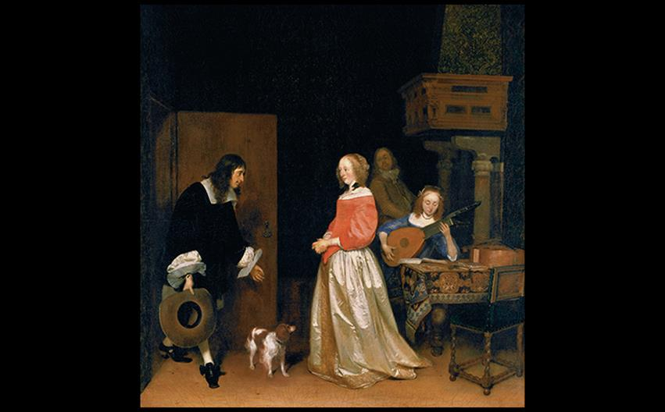
Gerard ter Borch THE SUITOR'S VISIT c. 1658. Oil on canvas, 32-1/2" × 29-5/8" (82.6 × 75.3 cm). National Gallery of Art, Washington, DC. Andrew W. Mellon Collection. Image courtesy the National Gallery of Art, Washington.
Notes:
Gerard ter Borch THE SUITOR'S VISIT c. 1658. Oil on canvas, 32-1/2" × 29-5/8" (82.6 × 75.3 cm). National Gallery of Art, Washington, DC. Andrew W. Mellon Collection. Image courtesy the National Gallery of Art, Washington.

Slide 42
Painting (12 of 14)
Genre Scenes
Jan Steen painted over 800 works, the most remarkable of which being paintings of children.
The Feast of St. Nicholas displays a household boisterous with a family get-together.
Children react in various ways to pre-Christmas gifts.

Slide 43
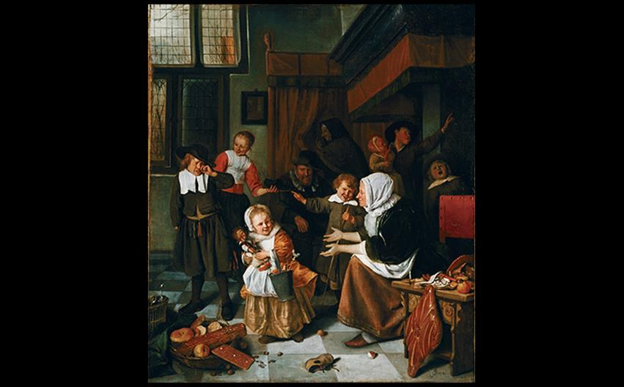
Jan Steen THE FEAST OF ST. NICHOLAS c. 1660–1665. Oil on canvas, 32-1/4" × 27-3/4" (82 × 70.5 cm). Rijksmuseum, Amsterdam.
Notes:
Jan Steen THE FEAST OF ST. NICHOLAS c. 1660–1665. Oil on canvas, 32-1/4" × 27-3/4" (82 × 70.5 cm). Rijksmuseum, Amsterdam.

Slide 44
Painting (13 of 14)
Genre Scenes
Emanuel de Witte specialized in architectural interiors, some called "portraits" of actual buildings.
Portuguese Synagogue, Amsterdam depicts an extant location and serves as a record of seventeenth-century synagogue architecture.
It reflects Dutch religious tolerance in an age where Jews were often persecuted.

Slide 45
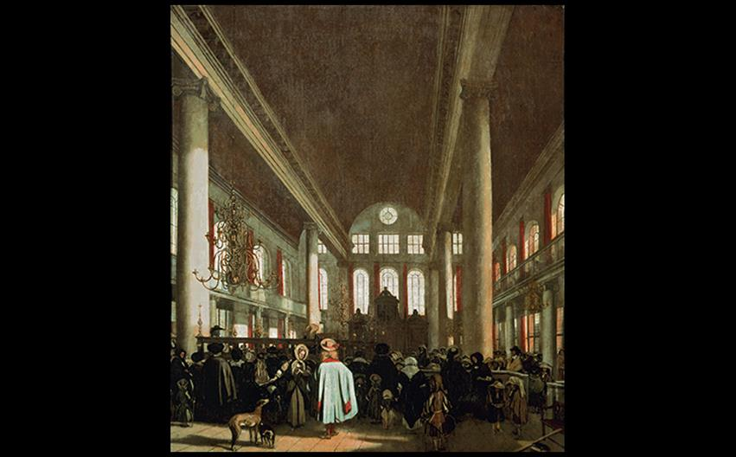
Emanuel de Witte PORTUGUESE SYNAGOGUE, AMSTERDAM 1680. Oil on canvas, 43-1/2" × 39" (110.5 × 99.1 cm). Rijksmuseum, Amsterdam.
Notes:
Emanuel de Witte PORTUGUESE SYNAGOGUE, AMSTERDAM 1680. Oil on canvas, 43-1/2" × 39" (110.5 × 99.1 cm). Rijksmuseum, Amsterdam.

Slide 46
Painting (14 of 14)
Landscape and Still Life
Jacob von Ruisdael's View of Haarlem from the Dunes at Overveen showcases the Dutch love of landscapes, with religious undertones of restoration following Noah's flood.

Slide 47
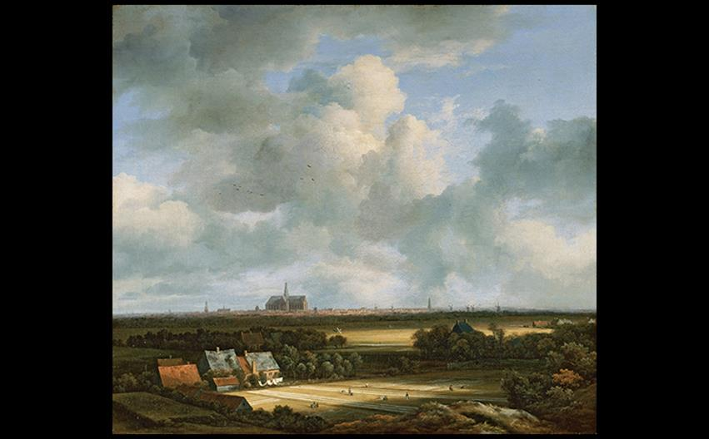
Jacob van Ruisdael VIEW OF HAARLEM FROM THE DUNES AT OVERVEEN c. 1670. Oil on canvas, 22" × 24-1/4" (55.8 × 62.8 cm). Royal Picture Gallery, Mauritshuis, The Hague.
Notes:
Jacob van Ruisdael VIEW OF HAARLEM FROM THE DUNES AT OVERVEEN c. 1670. Oil on canvas, 22" × 24-1/4" (55.8 × 62.8 cm). Royal Picture Gallery, Mauritshuis, The Hague.

Slide 48
The Dutch Republic (1 of 2)
Landscape and Still Life
Pieter Claesz, like Clara Peeters, painted "breakfast pieces" with nearly monochromatic colors.
Claesz gives the objects a strong sense of space and lifelikeness.
Contrast of textures and materials, such as the plainness of the food but the richness of the silver tazza, mark his mastery of the work.

Slide 49
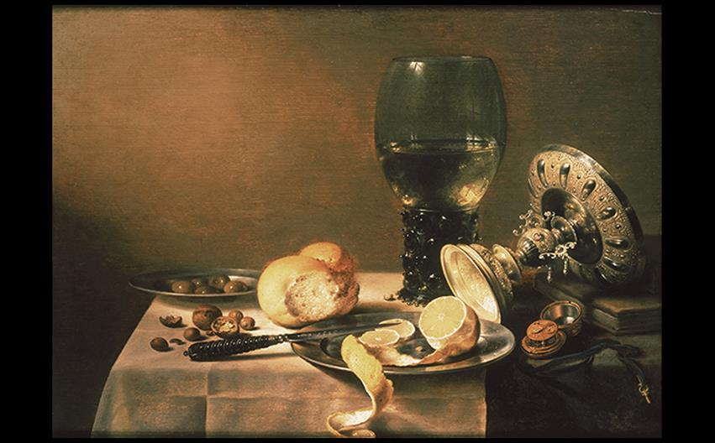
Pieter Claesz STILL LIFE WITH TAZZA 1636. Oil on panel, 17-3/8" × 24" (44 × 61 cm). Royal Cabinet of Paintings Mauritshuis, The Hague.
Notes:
Pieter Claesz STILL LIFE WITH TAZZA 1636. Oil on panel, 17-3/8" × 24" (44 × 61 cm). Royal Cabinet of Paintings Mauritshuis, The Hague.

Slide 50
The Dutch Republic (2 of 2)
Landscape and Still Life
Rachel Ruysch was a sought-after flower painter in Amsterdam with a 70-year career.
Flower Still Life may be a less daring work, but it is sumptuous and scientific in study.

Slide 51
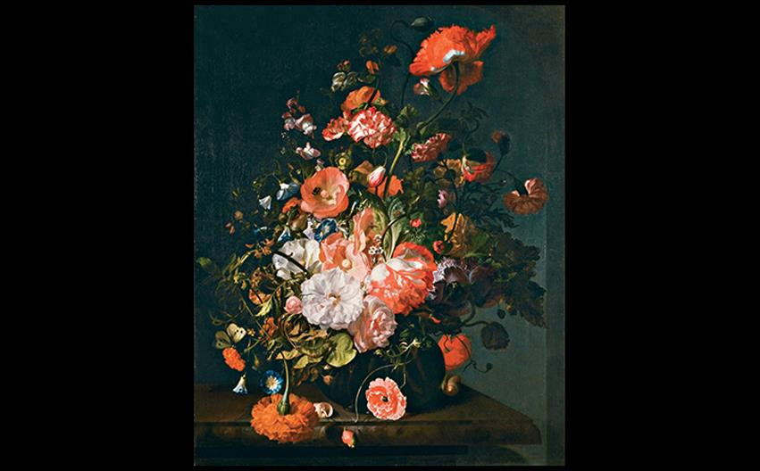
Rachel Ruysch FLOWER STILL LIFE After 1700. Oil on canvas, 30" × 24" (76.2 × 61 cm). The Toledo Museum of Art, Ohio. Purchased with funds from the Libbey Endowment. Gift of Edward Drummond Libbey (1956.57). The Toledo Museum of Art, Toledo, Ohio (1956.57)
Notes:
Rachel Ruysch FLOWER STILL LIFE After 1700. Oil on canvas, 30" × 24" (76.2 × 61 cm). The Toledo Museum of Art, Ohio. Purchased with funds from the Libbey Endowment. Gift of Edward Drummond Libbey (1956.57). The Toledo Museum of Art, Toledo, Ohio (1956.57)

Slide 52
Art and Its Contexts: Science and the Changing Worldview
Anna Maria Sibylla Merian (1647–1717) was a researcher and artist who published Metamorphosis of Insects in Surinam.
Large plates were engraved after her watercolors.
Francis Bacon and René Descartes insisted on scrupulous objectivity and logical reasoning in philosophy.

Slide 53
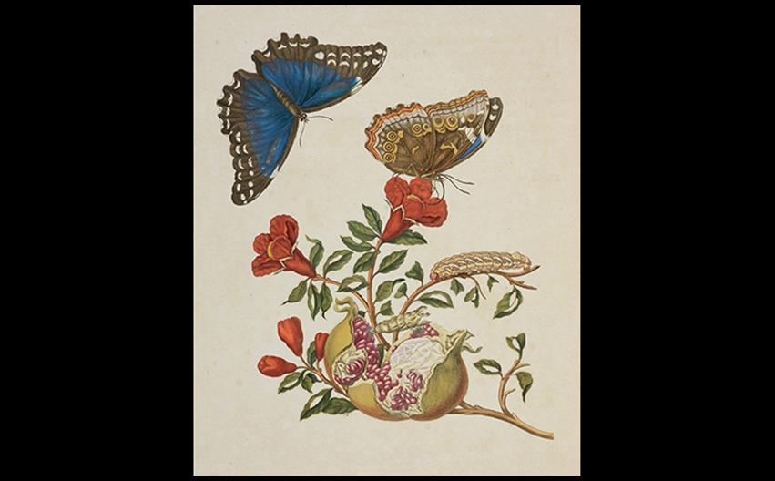
Anna Maria Sibylla Merian PLATE 9 FROM THE METAMORPHOSIS OF THE INSECTS OF SURINAM 1719. Hand-colored engraving, 18-7/8" × 13" (47.9 × 33 cm). Getty Research Institute, Los Angeles (89-B10750)
Notes:
Anna Maria Sibylla Merian PLATE 9 FROM THE METAMORPHOSIS OF THE INSECTS OF SURINAM 1719. Hand-colored engraving, 18-7/8" × 13" (47.9 × 33 cm). Getty Research Institute, Los Angeles (89-B10750)

